Slide 1
Case study: Global health funding
Dr Itamar Megiddo, Department of Management Science
Itamar.Megiddo@strath.ac.uk

Slide 2







Work with global health funders to prioritize their investment

Slide 3
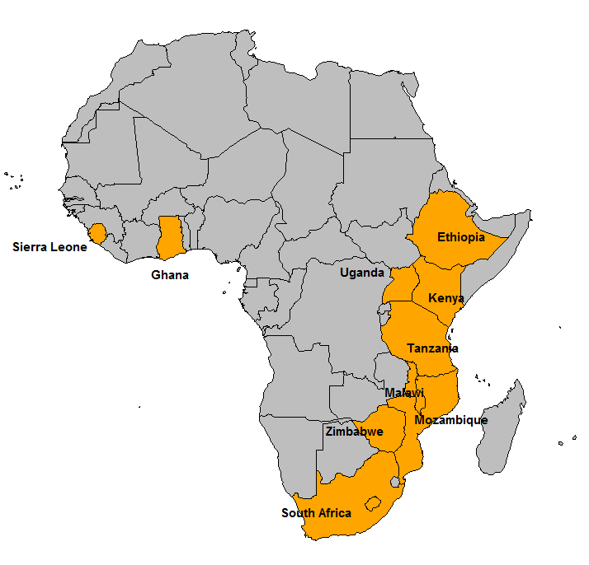
The Decision-Making Context: The Client
Global health funder that focuses on 10 countries in sub-Saharan Africa
Their objective is to reduce the disease burden as well as the financial burden on households (out-of-pocket expenditure)

Slide 4
The Decision-Making Context: The Problem
Global health funder decision on prioritizing funding programs
Recommend a priority list of 4 programs (diseases) to invest in over 2 countries.
Example priority list:
Malaria in Ethiopia
Neonatal disorders in Malawi
Non-Communicable diseases in Ghana
Maternal disorders in in Ghana
* Note: this list is just an example and is not based on data

Slide 5
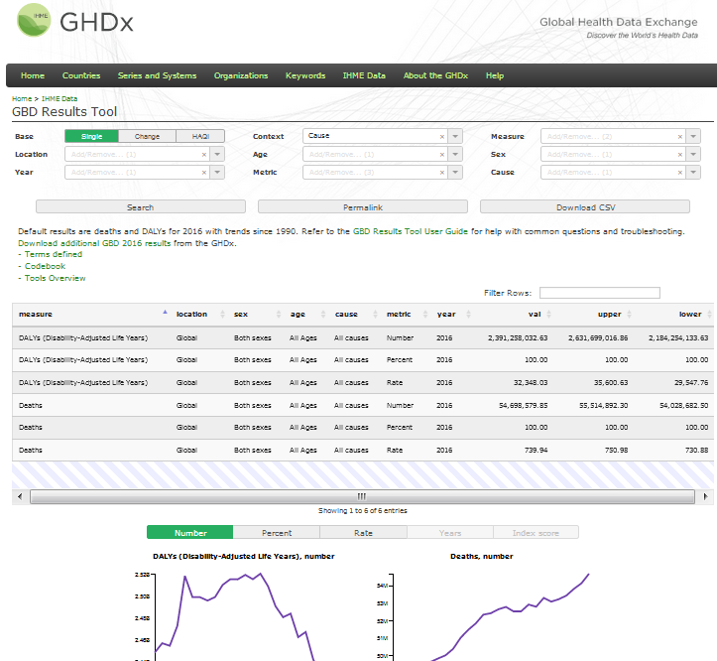
The Data (the data is available on Myplace)
By country, year, sex, age-group, and cause (disease; approx 30 causes in data)
Disease incidence (as the number of cases per year)
Deaths per year
Disability-Adjusted Life Years (DALYs) – combines mortality and morbidity
The Global Burden of Disease (GBD) data produced by the Institute of Health Metrics and Evaluation (IHME) at the University of Washington (http://ghdx.healthdata.org/gbd-results-tool)

Slide 6
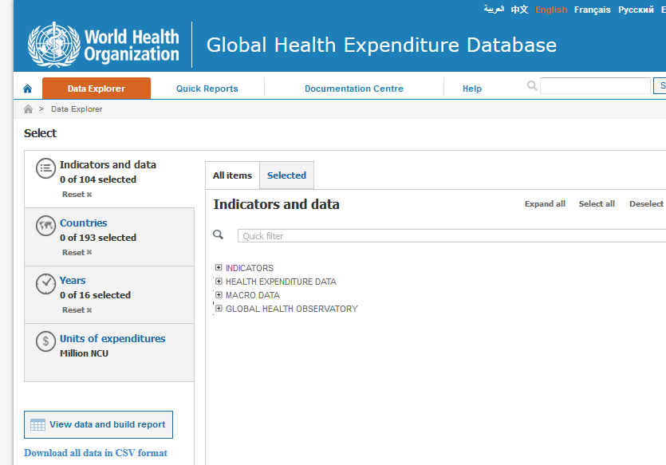
The Data (the data is available on Myplace)
By country and year
Various variables on health expenditure by the government, households, and external funders
Generic health metrics (e.g., life-expectancy, infant mortality rate)
GDP
Population
The World Health Organization (WHO) Global Health Expenditure Database (http://apps.who.int/nha/database/)

Slide 7
Combine the datasets
The Global Burden of Disease (GBD) data produced by the Institute of Health Metrics and Evaluation (IHME) at the University of Washington (http://ghdx.healthdata.org/gbd-results-tool)
The World Health Organization (WHO) Global Health Expenditure Database (http://apps.who.int/nha/database/)

Slide 8
Recap of what I need from you
Each group to focus on 2 countries
Set a priority list of 4 causes/diseases to invest in over the 2 countries
Important criteria are disease burden and out-of-pocket expenditure
Up to you who to target (e.g., worse off or where investment has higher impact).
Provide evidence for your priority list
Figures
Summary statistics

Slide 9
Deliverables
5 minute presentation
12:15 on Friday 28th September
Written report (max 4 pages)

Slide 10
Report
Very short executive summary
Audience: policy makers
Any technical details in an appendix – max one page
References, if needed
Upload report and presentation to MyPlace (one submission to both MS930 & MS984 sites) by 9am 28th September

Slide 11
Contact Itamar
Itamar.Megiddo@strath.ac.uk
Max 1 email per group
Office hours: Wed 2-4PM, Room DW713

